Slide 1
ASP.NET MVC
Lesson 9 Components

Slide 2
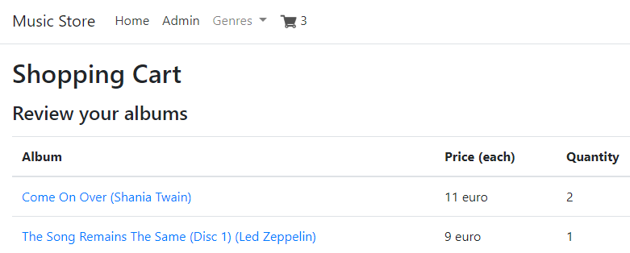
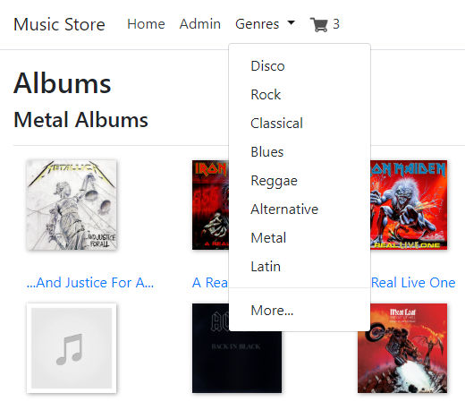
Extra Functionalities
Helpers
Components
Music Store

Slide 3
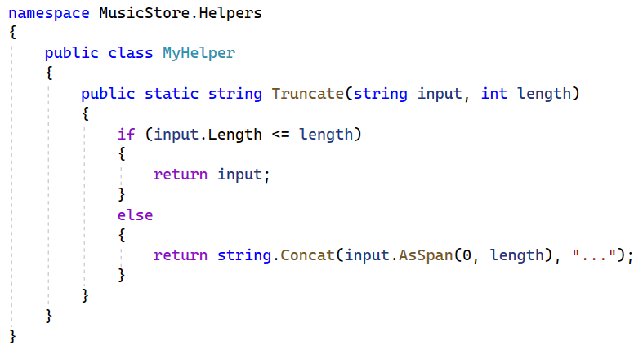
MyHelper
MusicStore | Add New Folder | Helpers
Helpers | Add | Class | MyHelper.cs

Slide 4
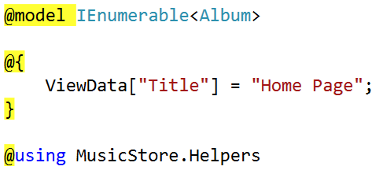
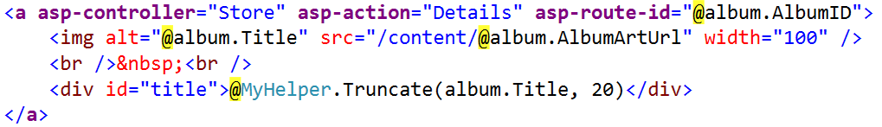
Views/Home/Index.cshtml

Slide 5
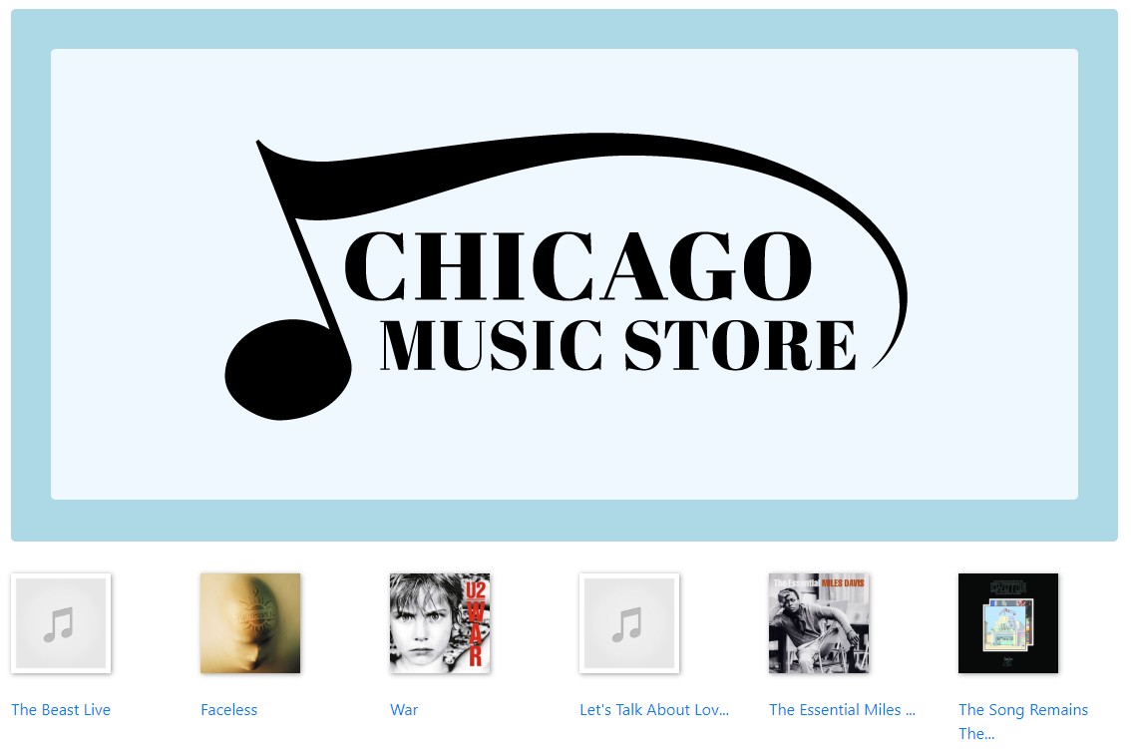
Home

Slide 6
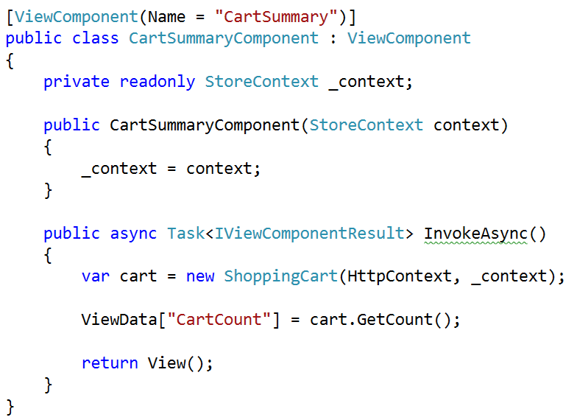

CartSUmmaryComponent.cs
MusicStore | Add New Folder
| Components
CartSummaryComponent.cs

Slide 7
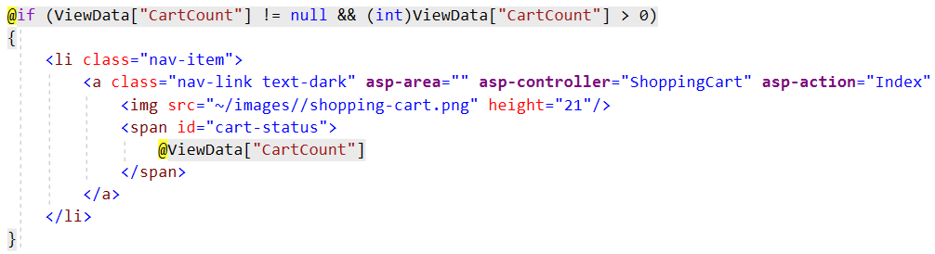
Default.cshtml
Views/Shared | Add New Folder | Components
Components | Add New Folder | CartSummary
Default.cshtml

Slide 8
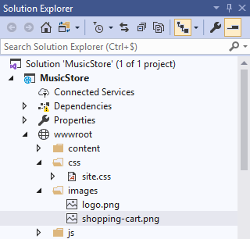
_Layout.cshtml
shopping-cart.png (from resources to wwwroot/images)

Slide 9
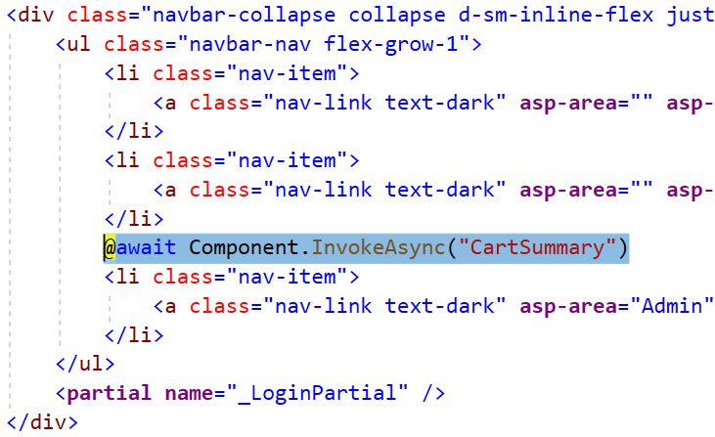
_Layout.cshtml

Slide 10
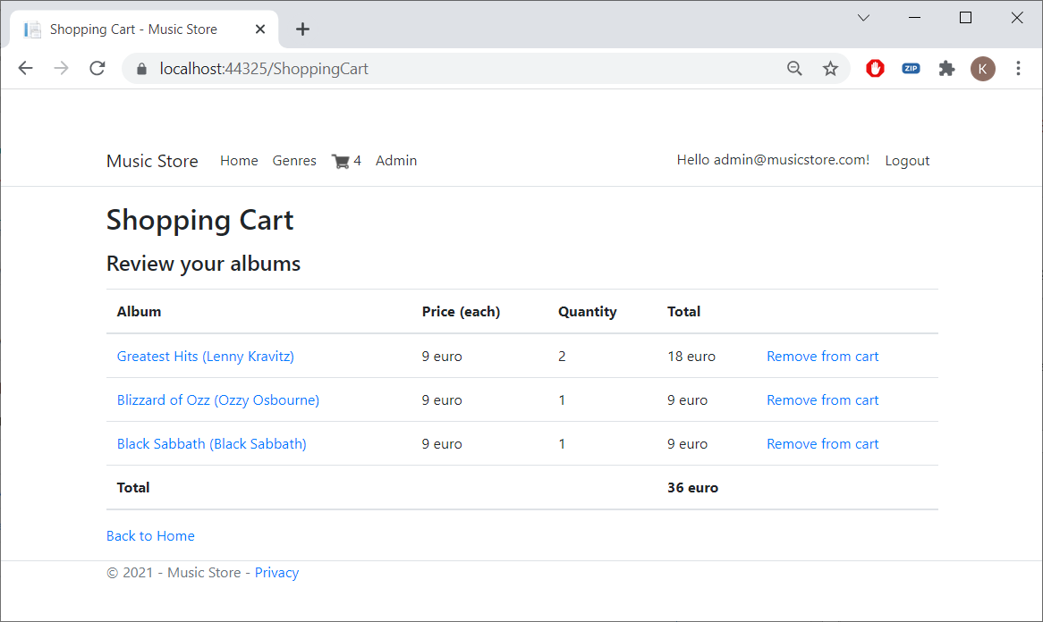
Shoppingcart

Slide 11
Exercise
Music Store Part 4

